Slide 1
Operations

Slide 2
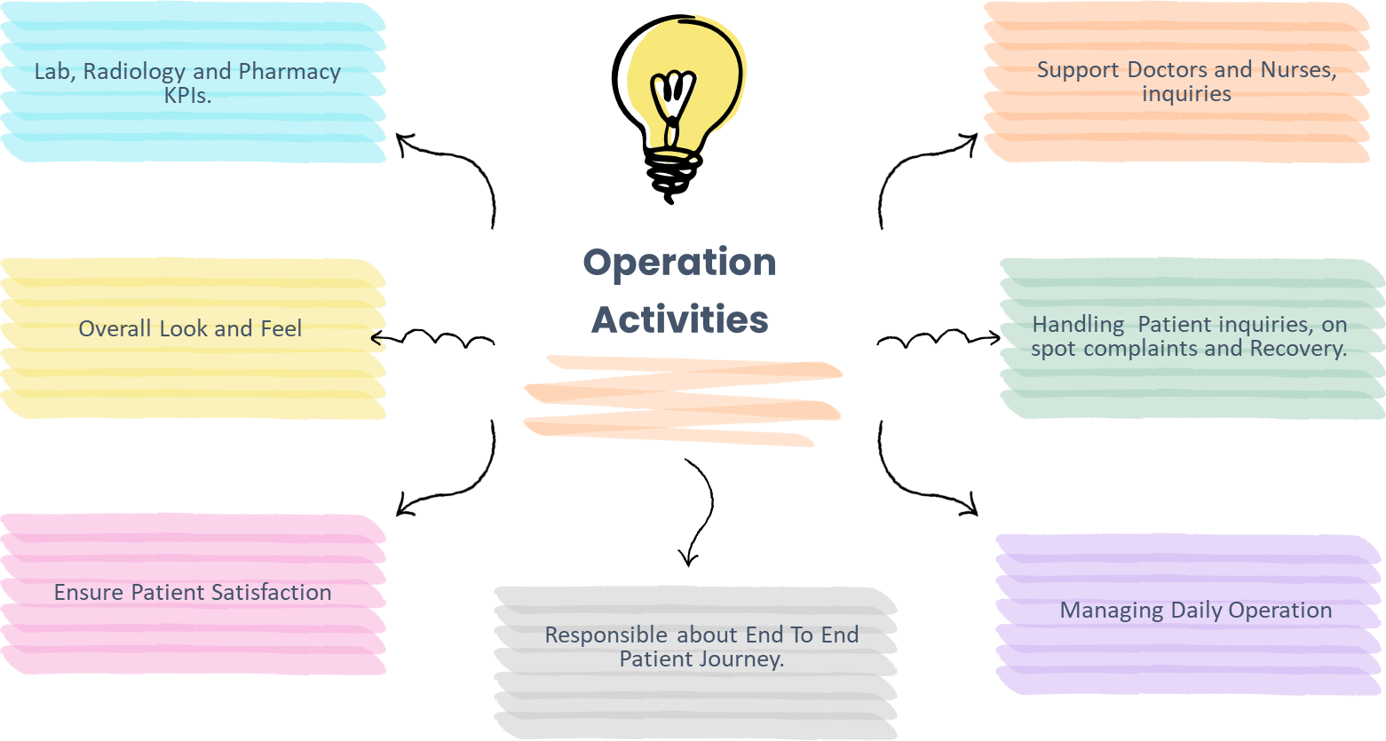

Slide 3








Operations Structure
Haytham El Sini
Director of Operations
Shahad Hassubah
Albaraa Kinani
Dr. Wail Ahmed
Patient Experience & Operations Sr. Manager
Patient Access & PX Sr. Manager
Operations Sr. Manager
J1
J3
J4
J2
PR1
Check Up Unit
In Patient
Ahmed Malaka
Pre-employment Supervisor
Merih Bokhre
Leader
3
PXOs
3
PXOs
1
FM
7
PXOs
2
PXOs
2
Coords
Ahmed Muzaffar
Patient Experience Manager
Ismail Alsarmi
Acting Patient Experience Manager
VIP Team
6
FMs
35
PXOs
2
FMs
16
PXOs
3
Coords

Slide 4
My Care

Slide 5
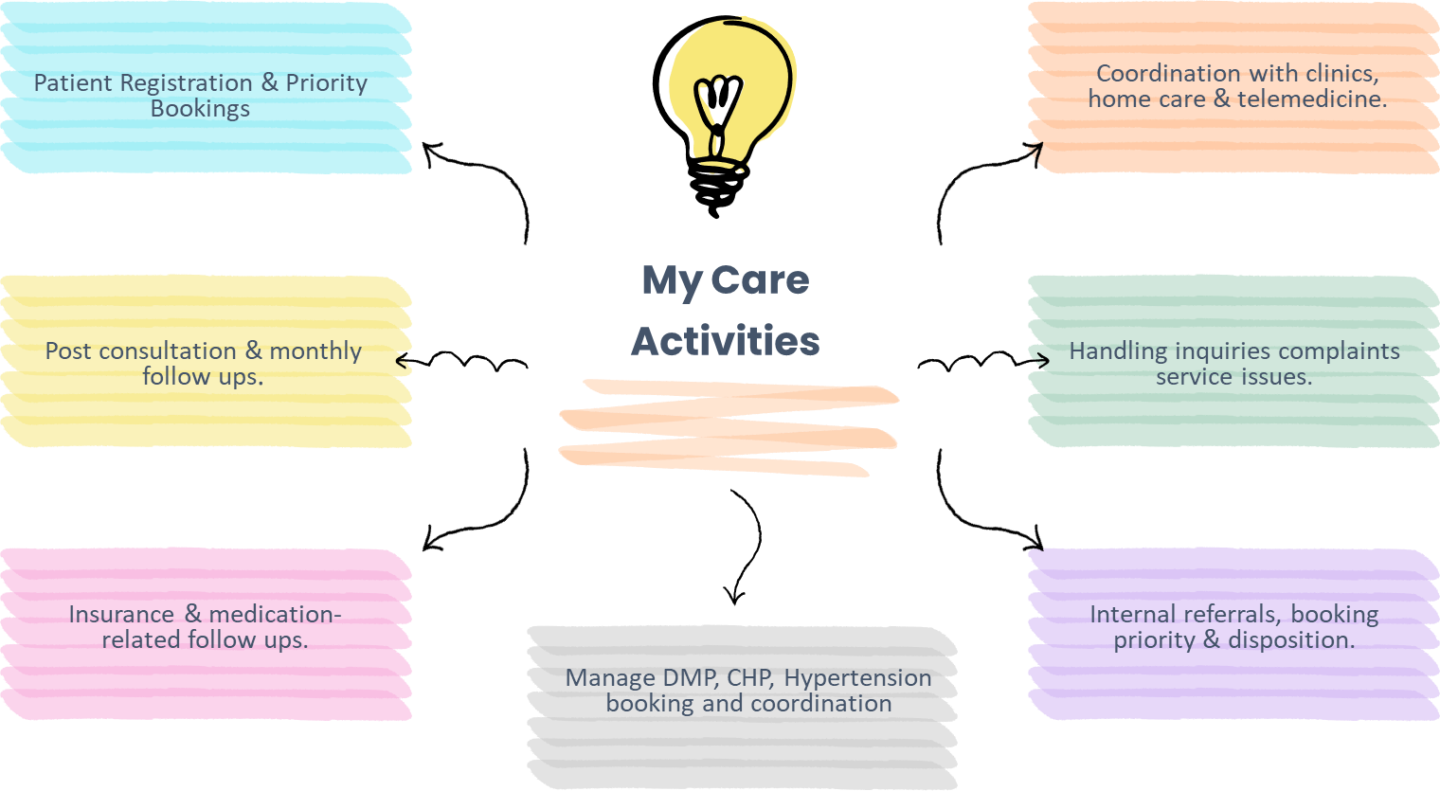

Slide 6
My Care Structure
Haytham El Sini
Director of Operations
Albaraa Kinani
Patient Access & PX Sr. Manager
Wejdan Shawak
Nariman Alayoubi
Quality Assurance Leader
My Care Manager
Sara Jalal
My Care Onboarding Leader
Mahmoud Mohammed
My Care Onboarding Leader
Hanouf Makki
My care Leader J2, J3 and J4
Raad Bokhari
My care Leader J1
8
Coords
8
Coords
2
Coords
22
Coords
38
Coords

